Slide 1
Workshop
DEFROST team

Slide 2
General overview of the Tutorial

Slide 3
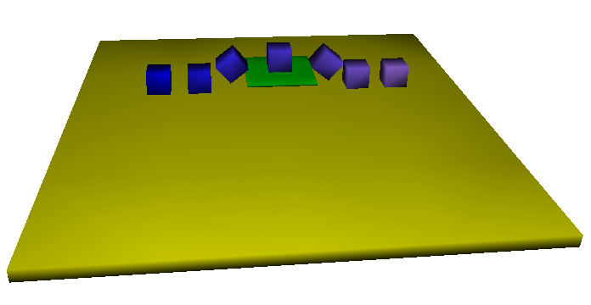
Session 1
9:00 am to 9:45 am: Presentation of SOFA & general concepts (presentation)
9:45 am to 10:30 am: First-steps tutorial (practice)

Slide 4
Session 2
11:00 am to 11:30 am:
Objectives of the tutorial and theoretical concepts (presentation)
11:30 am to 12:00 am:
Modeling with FEM, placement of the servomotors (practice)
12:00 am to 12:30 am:
Deformable-Rigid coupling (presentation & practice)
12:30 am to 1:00 pm:
Contact modeling (presentation & practice)

Slide 5
Session 3
2:00 pm to 2:30 pm: Interfacing simulation with hardware (practice)
2:30 pm to 3:00 pm: Inverse Kinematic (presentation & practice)
3:00 pm to 3:30 pm: Interfacing simulation to a camera with ROS (demo)
3:30 pm to 4:00 pm:
Closed-loop control (presentation & demo)

Slide 6
SOFA-FRAMEWORK
www.sofa-framework.org

Slide 7
Context
SOFA: A shared framework between several research teams
Real-time simulation of physical phenomena but more particularly deformable solid mechanics
Open-source framework (LGPL)
Used to create 2 start-up in France (InSimo and Anatoscope)
Before 2015… Mostly centered on medical simulation
Simulation of soft-tistsues
Interactions with medical instruments
Haptic rendering…

Slide 8
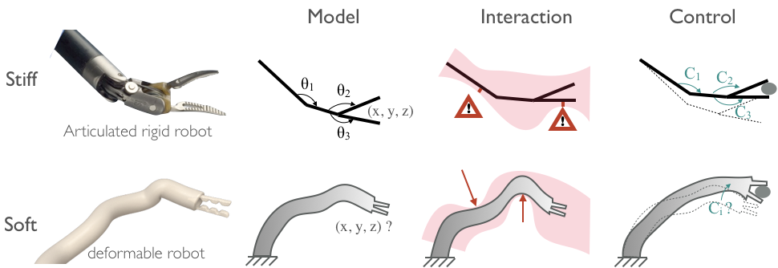
Context
2015 creation of DEFROST team (Inria, Univ. Lille, CNRS, Centrale Lille)
Use of SOFA for modeling soft robots in real-time
Take into account the interactions with the environment
Create new control methods

Slide 9
Context
Organization of the code
SOFA-CORE: public (LGPL licence)
C++ classes
Versioning using GIT
Main functionalities
Public plugins:
Python binding (LGPL licence)
Soft-robot direct modeling (LGPL licence)
Model order reduction (GPL licence)
…
Private plugins (binaries distributed freely today only for research)
Soft-robot inverse
Beam Adapter

Slide 10
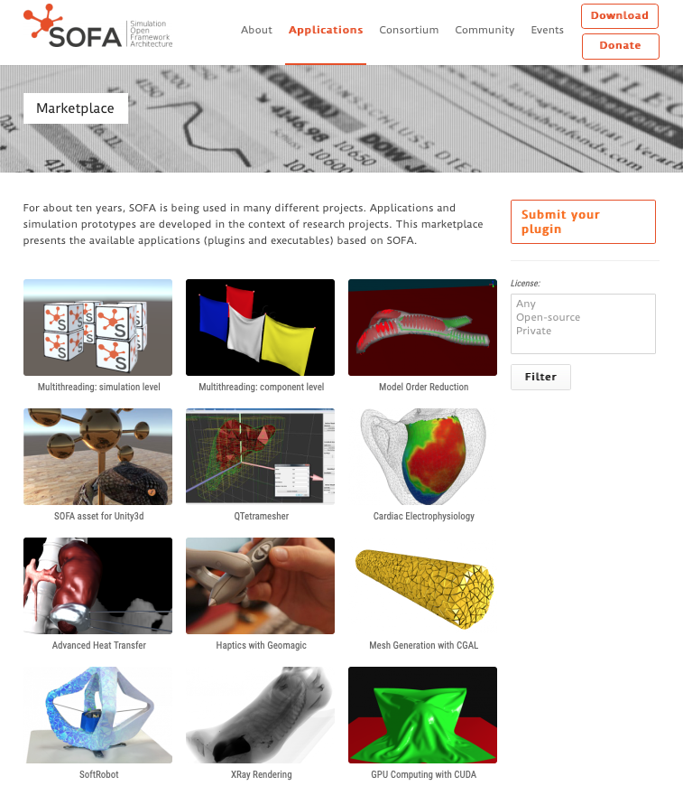
Context

Slide 11
Context
Software architecture
Compilation using CMake
de/activate options
shadow builds (own configs)
ease the dependency management
Compatible with Linux / MacOS / Windows

Slide 12
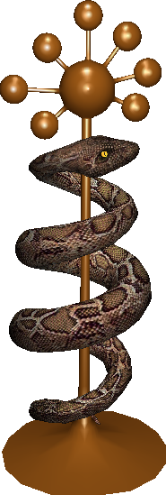
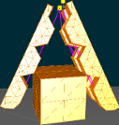
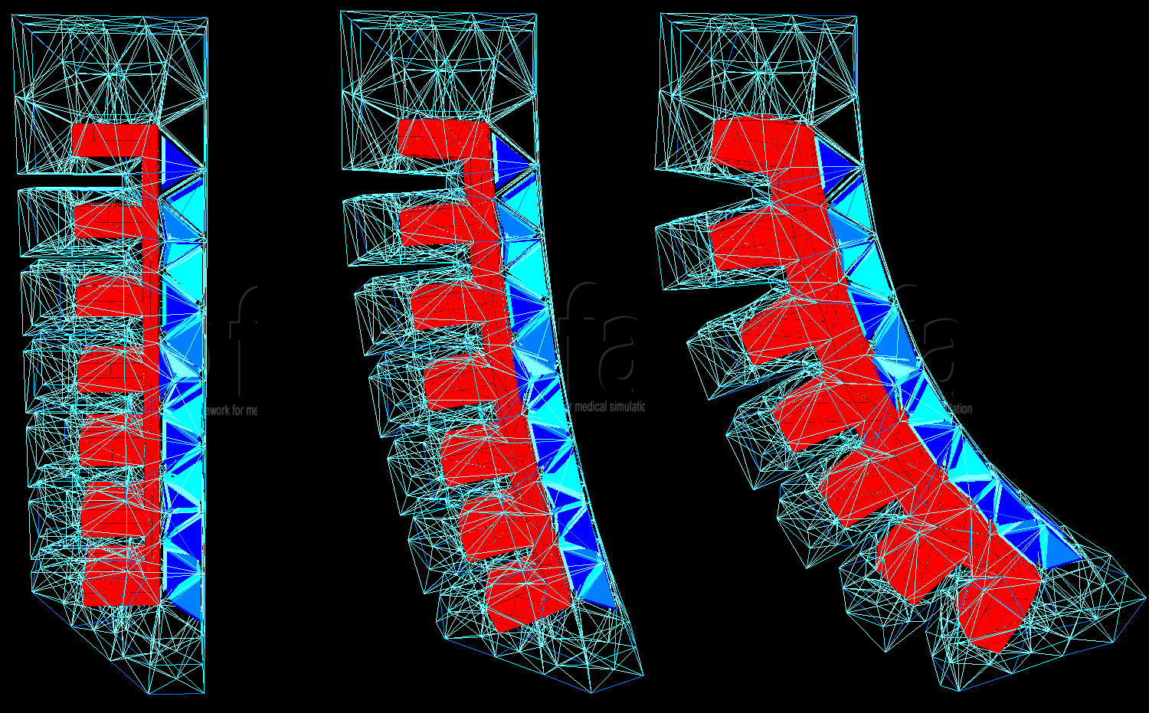
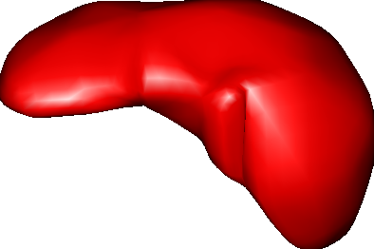
Main principles of SOFA - A simulation in SOFA -

Slide 13
Main principles of SOFA :: the graph
Hierarchical representation of simulated objects
Scene organized as a graph (Directed Acyclic Graph, i.e. generalized hierarchy)
composed of nodes
nodes contain components
components have features (Data)
Data can be connected together

Slide 14
Main principles of SOFA :: the graph
Hierarchical representation of simulated objects
Scene organized as a graph (Directed Acyclic Graph, i.e. generalized hierarchy)
composed of nodes
nodes contain components
components have features (Data)
Data can be connected together
Let’s try…

Slide 15
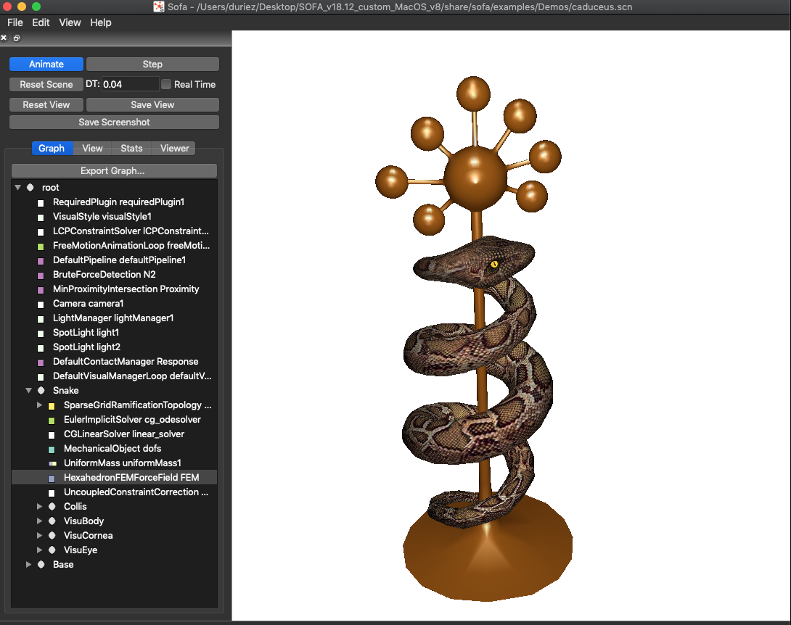
Main principles of SOFA :: the graph
Scene Graph
Nodes
Components
Data in components

Slide 16
Main principles of SOFA :: multi-level of abstraction
Multi-model representation
FEM (mechanics)
Collision
Visualization

Slide 17
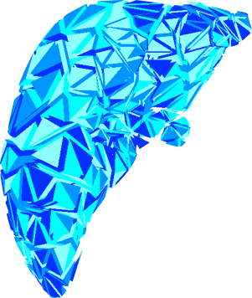
Main principles of SOFA :: multi-level of abstraction
Split computation into independent components
Separate problems
Improve reusability
Deformable model

Slide 18
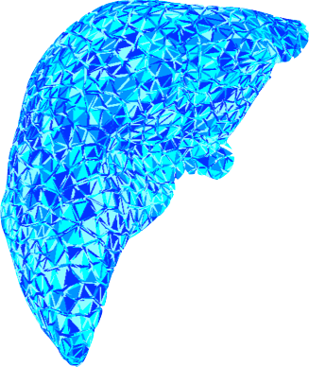
Main principles of SOFA :: multi-level of abstraction
Split computation into independent components
Separate problems
Improve reusability
Computation on GPU

Slide 19
Main principles of SOFA :: multi-level of abstraction
Use of templates for most components
(+) Facilitates the combination of objects of very different nature
(+) Allows the use of specific data representation, such as the ones handled by GPUs
(-) C++ code is complex

Slide 20
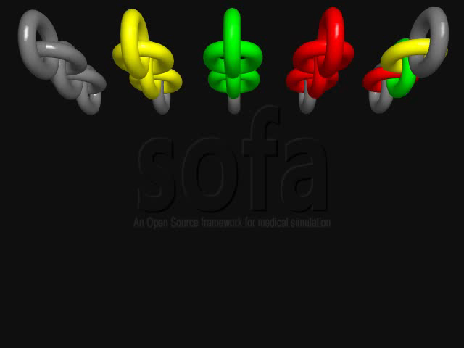
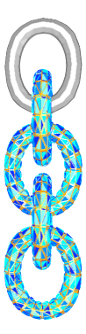
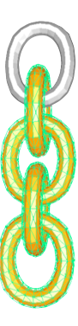
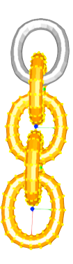
Main principles of SOFA :: multi-level of abstraction
Spring Mass
share/sofa/examples/Demos/chainHybrid
FEM
Rigid

Slide 21
Main principles of SOFA :: main components
Mechanical Object
Mapping
Solvers
ForceField
Topology
Collision Models
Visual Models

Slide 22
Main principles of SOFA :: main components
Mechanical Object
store the state vector (DOF)
template: any geometry type (rigid, frame, 1d, 2d, 3d, 6d …)
Importance of its place in the graph !

Slide 23
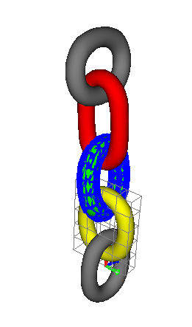
Main principles of SOFA :: main components
Mechanical Object
FEM Model
DOFs: positions of nodes (Vec3)
Rigid Model
DOFs: positions and orientation
of gravity center (Rigid)

Slide 24
Main principles of SOFA :: main components
Mapped Mechanical objects: slave models
position and velocity imposed by the mapping of a parent MechanicalObject
force can be applied on slave models and transmitted to the parent

Slide 25
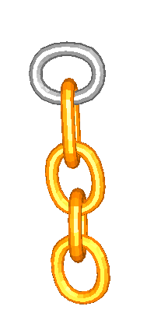
Main principles of SOFA :: main components
Mapped Mechanical objects: slave models
FEM Model
DOFs: positions of nodes (Vec3)
Rigid Model
DOFs: positions and orientation
of gravity center (Rigid)
Collision Model
Mapped DOFs: positions of points (Vec3)
BarycentricMapping
Collision Model
Mapped DOFs: positions of points (Vec3)
RigidMapping

Slide 26
Main principles of SOFA :: main components
Mapping
Allow to transfer the motion (pos, vel) to a « slave » model
Allow to transfer back to the « parent » model some Forces

Slide 27
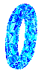
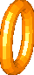
Main principles of SOFA :: main components
Mapping
Allow to transfer the motion (pos, vel) to a « slave » model
Allow to transfer back to the « parent » model some Forces
FEM Model
DOFs: positions of nodes (Vec3)
Collision Model
Mapped DOFs: positions of points (Vec3)
BarycentricMapping

Slide 28
Main principles of SOFA :: main components
Mapping
Allow to transfer the motion (pos, vel) to a « slave » model
Allow to transfer back to the « parent » model some Forces
FEM Model
DOFs: positions of nodes (Vec3)
imposed positions and velocities
Collision Model
Mapped DOFs: positions of points (Vec3)
BarycentricMapping

Slide 29
Main principles of SOFA :: main components
Mapping
Allow to transfer the motion (pos, vel) to a « slave » model
Allow to transfer back to the « parent » model some Forces
FEM Model
DOFs: positions of nodes (Vec3)
Add forces and constraints
Collision Model
Mapped DOFs: positions of points (Vec3)
BarycentricMapping

Slide 30
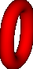
Main principles of SOFA :: main components
Mapping
Allow to transfer the motion (pos, vel) to a « slave » model
Allow to transfer back to the « parent » model some Forces
FEM Model
DOFs: positions of nodes (Vec3)
imposed positions
Visual Model

Slide 31
Main principles of SOFA :: main components
Solvers
Time integration (Implicit, Explicit)
Linear Solver (how to solve the system of equations ?)
Based on visitors
Importance of their place in the hierarchical structure
All non-mapped mechanical objects hierarchically placed under the solver are considered to be DOFs

Slide 32
Main principles of SOFA :: main components
Case 1: independent solvers
ROOT
FEM Model
Solver (size 3n)
DOFs: n nodes (Vec3)
Rigid Model
Solver (Size 6)
DOFs: 1 Frame(Rigid)
Collision Model
Mapped DOFs: positions of points (Vec3)
BarycentricMapping
Collision Model
Mapped DOFs: positions of points (Vec3)
RigidMapping

Slide 33
Main principles of SOFA :: main components
Case 2: same solver
ROOT
Solver (size 3n + 6)
Rigid Model
DOFs: 1 Frame (Rigid)
FEM Model
DOFs: n nodes (Vec3)
Collision Model
Mapped DOFs: positions of points (Vec3)
BarycentricMapping
Collision Model
Mapped DOFs: positions of points (Vec3)
RigidMapping

Slide 34
Main principles of SOFA :: main components
ForceFields
FEM Model
EulerImplicit + CGSolver
MecaObject: nodes (Vec3)
TetrahedronFEMForceField
Spring Model
EulerImplicit + CGSolver
MecaObject: nodes (Vec3)
MeshSpringForceField
FFD Model
EulerImplicit + CGSolver
MecaObject: nodes (Vec3)
RegularGridSpringForceField

Slide 35
Main principles of SOFA :: main components
ForceFields
Springs
Mass
Internal forces computed by FEM
Different elements: Tetrahedral, Hexahedral, Beam, ..
Corotational, Hyperelastic approaches
Described in an unified way to re-use other components of SOFA, like Mechanical objects and solvers

Slide 36
Main principles of SOFA :: main components
Topology
Load a mesh
geometry (points)
Connectivity of those points
Triangle
Tetrahedron
Edge
Quad
Hexahedron

Slide 37
Main principles of SOFA :: main components
Possible different topology for each representation (physics, visual, collision)
Mappings links them

Slide 38
Main principles of SOFA :: main components
Collision model = geometrical representation supporting collisions
Implemented models
sphere
triangle
point
line
oriented bounding box

Slide 39
Main principles of SOFA :: main components
Collision in 3 steps
Broad phase = intersection of bounding boxes (pairs)
Narrow phase = computation of intersection (descending hierarchy)
Response

Slide 40
Main principles of SOFA :: main components
Collision in 3 steps
Broad phase = intersection of bounding boxes (pairs)
Narrow phase = computation of intersection (descending hierarchy)
Response
Discret intersection method
Layer depth image
Distance maps

Slide 41
Main principles of SOFA :: main components
Collision in 3 steps
Broad phase = intersection of bounding boxes (pairs)
Narrow phase = computation of intersection (descending hierarchy)
Response
Penalty methods
Lagrange multiplier constraint

Slide 42
Main principles of SOFA :: Features
Mechanical models
Rigid bodies
Articulated rigid bodies
Deformable models
FEM: 6 different models including MJED, Co-Rotational, TLED, in CPU and GPU versions
Spring-Mass model (CPU + GPU)
Grid-based deformable model
Beam model (for vessels, catheters, surgical thread, ...)
Shell model for hollow structures
and several others…

Slide 43
Main principles of SOFA :: Features
Contact response & interactions
Penalty based approach for contacts : Explicit or Implicit integration
Constraint based approach for contacts
Linear Complementarity Constraint (LCP) solvers for contacts, NLCP solvers for friction contacts
individual optimization for the computation of the contact response (depending of the mechanical model)
Other type of interaction forces or constraints (attachement, sliding points...)

Slide 44
Main principles of SOFA :: Features
Solvers
Different type of ODE Solvers: Explicit and Implicit Euler, Newmark scheme, Runge Kutta...
Efficient solvers for linear matrix systems : (Preconditioned) conjugate gradient, direct solvers (sparse and band tri-diagonal systems), GPU-based solvers
Multi-grid solvers for volume deformable objects

Slide 45
Main principles of SOFA :: Features
Python binding
on-the-fly modifications: data, object creations
fast prototyping (w/o C++ skills)
creation of « controllers » : script that take control of object in the simulation or define new user interactions (keyboard, mouse…)
Creation of « prefab » (presentation during session 2)

Slide 46
Main principles of SOFA :: conclusion
High modularity
Efficiency of the implementation
Fast prototyping
Hierarchical description of models
Multimodel simulations using mappings
wide range of algorithms and solvers
More than a research project…
750, 000 lines of C++ / open-source / gitHub
cross-platform: Linux, Mac, Win
Importance of having a consortium with active support.
The bigger the community, the better…

Slide 47
Deformable-rigid coupling
Why composite mechanics ?
Soft robot can be composed of rigid sections (backbones)
Importance of computing the coupling between rigid parts and deformable parts.
Rigid
Deformable
Deformable
Slave nodes

Slide 48
Deformable-rigid coupling
Rigid Frame
Hierarchical representation
Slave nodes
Rigid Mapping
Slave nodes

Slide 49
Deformable-rigid coupling
Rigid Frame
Hierarchical representation
remaining FEM nodes
Slave nodes
Rigid Mapping
Slave nodes

Slide 50
Deformable-rigid coupling
Rigid Frame
Hierarchical representation
remaining FEM nodes
Slave nodes
?
Rigid Mapping
Slave nodes
FEM computation ?

Slide 51
Deformable-rigid coupling
Rigid Frame
Hierarchical representation
Multi-Mapping Concept
remaining FEM nodes
Slave nodes
?
Rigid Mapping
Slave nodes
FEM computation
SubsetMultiMapping
FEM ForceField

Slide 52
Deformable-rigid coupling
Rigid Frame
Hierarchical representation
Multi-Mapping Concept
remaining FEM nodes
internal
Forces
internal
Forces
Slave nodes
Rigid Mapping
Slave nodes
internal
Forces
FEM computation
SubsetMultiMapping
FEM ForceField

Slide 53
Deformable-rigid coupling
Solver (size 3n + 6)
Hierarchical representation
Multi-Mapping Concept
Common solver
1 Rigid Frame
internal
Forces
n remaining FEM nodes
internal
Forces
Slave nodes
Slave nodes
internal
Forces
Rigid Mapping
FEM computation
SubsetMultiMapping
FEM ForceField

Slide 54
Deformable-rigid coupling
Solver (size 3n + 6)
Hierarchical representation
Multi-Mapping Concept
Common solver
K
K
J
dx
J^{T}
K
K
dq
Slave nodes
J^{T}
J
J
with
jacobian of the Rigid Mapping

